Slide 1


Titolo presentazione sottotitolo
COMPUTER MUSIC-LANGUAGES & SYSTEMS
FABFOUR | HOMEWORK #3
Milano, XX mese 20XX
Presented by:
Amico Stefano Antonio(10937333)
Anand Abhijeet(10859656)
Pletti Manfredi(10493741)
Portentoso Alice(10664207)
Presented to:
Prof. Fabio Antonacci
Prof. Marco Olivieri

Slide 2
ABOUT
Topic : Design and implementation of a computer music system
Objectives :
To implement a complete computer music system with interaction design principles.
The purpose, the state of tools and communication protocols should be decided.
Developed tool : FabStick (A Fabulous [drum] Stick)
Softwares used : SuperCollider IDE, Arduino, TouchOSC and Processing
Hardwares used : Arduino
Github link : https://github.com/polimi-cmls-23/group6-hw-CMS-Fab_Four
Features :
Generates ‘hit data’ based on a performer’s movements and velocity data from a stick like a drumstick, sensed by an Arduino equipped with an accelerometer sensor.
OSC messages are transmitted wirelessly through UDP packets to Supercollider, which generates the audio.
The performer has real-time control over amplitude, frequency, reverb and delay via a wireless controller based on TouchOSC.

Slide 3
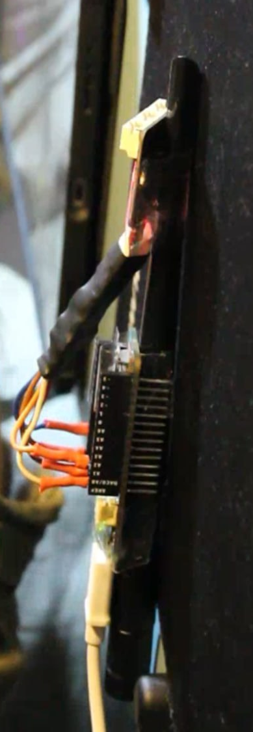
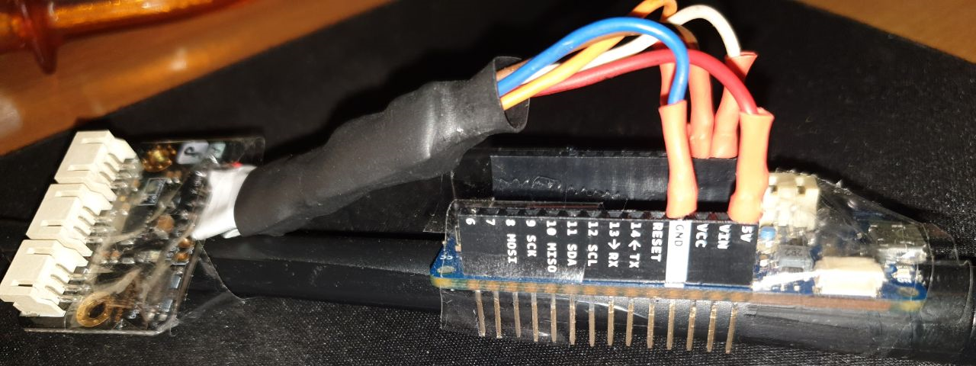
BLOCK DIAGRAM & PHYSICAL SETUP

Slide 4
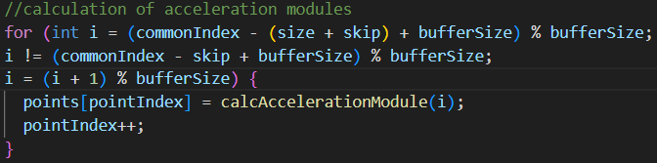
OVERVIEW- ARDUINO SCRIPT
Responsible for :
CONNECTION SETUP:
Setting up the Wi-fi module.
ACCELEROMETER INITIALIZATION AND DATA ACQUISITION:
The BMI160 accelerometer is initialized with I2C communication, set to a 16g range, and set to a rate of 800Hz.
Acceleration is measured by calling
the calcAccelMean() function
which reads accelerometer data,
calculates the acceleration on each axis, and then returns the average value.
STROKE DETECTION:
Based on acceleration and slope stored in buffers (accelerationBuffer
and slopeBuffer). The function detectStroke() implements the stroke detection logic, which is based on thresholds. If a stroke is detected, the stroke’s velocity is calculated based on the acceleration and the slope right before of the stroke and sent as UDP packet.
Arduino Script Repo: https://github.com/polimi-cmls-23/group6-hw-CMS-Fab_Four/blob/main/FabStick/FabStick.ino

Slide 5
OVERVIEW- SUPERCOLLIDER SCRIPT
Makes use of OSC to communicate with other applications, routing signals through audio and control busses, and creating different sound effects.
INITIAL SETUP:
sensorValue and sensorTrigger stores values from external sensor via OSC,
x and y as control busses handle incoming touch OSC data, and reverbBus and delayBus handles signals through reverb and delay effects, respectively.
SYNTH DEFINITIONS:
Defines several synth designs(i.e., reverbEffect, delayEffect, hit).
EFFECTS SYNTH INSTANTIATION:
instantiates the effects synths for reverb and delay.
OSC MANANGEMENT:
The /sensor OSC message updates sensorValue and triggers the hit synth. The /XY/1 OSC message updates the x and y control busses and sends their values to a separate processing application. OSC messages for /roomsize, /revtime, /rwet, /delaytime, /decaytime, and /dwet all update corresponding parameters in the reverb and delay synths send messages to the processing application.
Python Server Script Repo: https://github.com/polimi-cmls-23/group6-hw-CMS-Fab_Four/blob/main/FabStick.scd

Slide 6
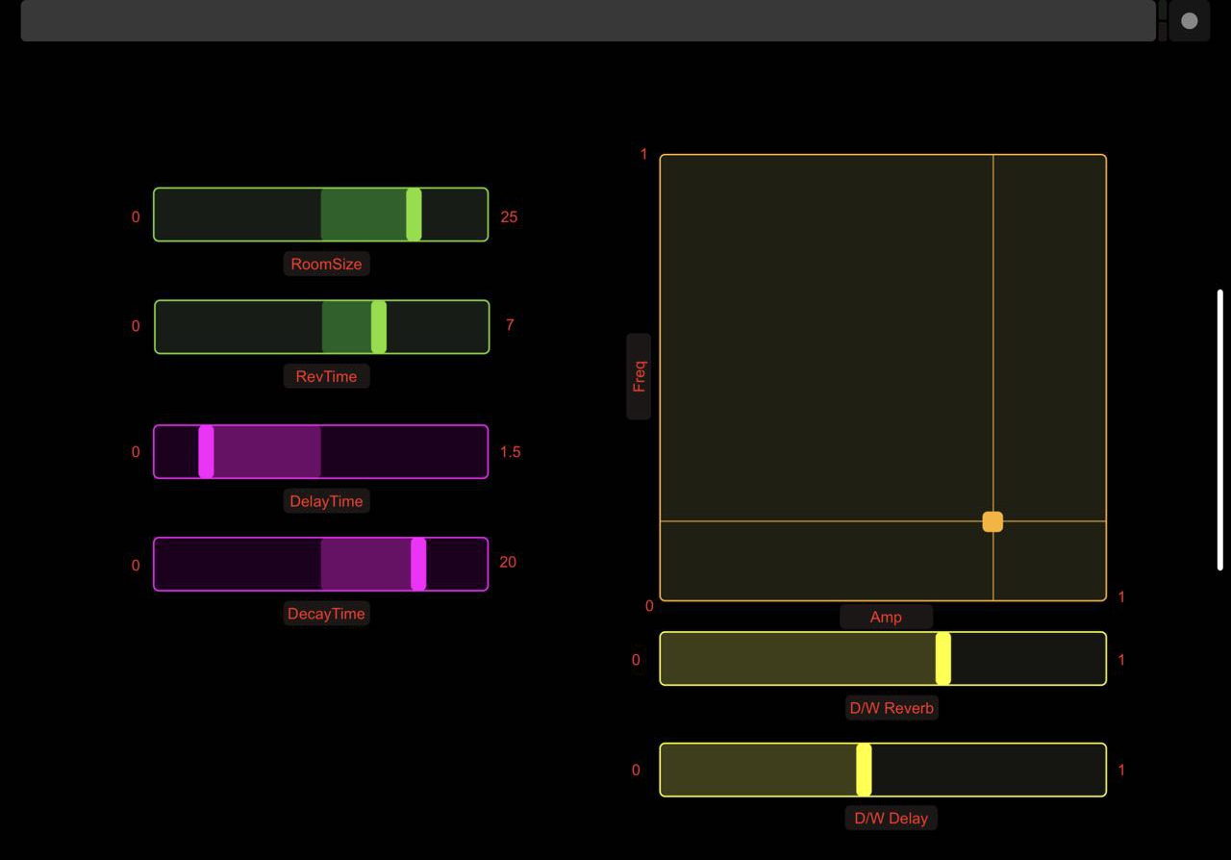
TOUCH OSC LAYOUT
Each controller sends OSC messages as the corresponding labeled values.On XY pad, x-axis controls the amplitude, y-axis controls the cut-off frequency of a high pass filter.

Slide 7
PROCESSING
The Processing script visualizes the sound parameters by communicating with the SuperCollider program that contain X and Y positions of the TouchOSC controller. These positions are then visualized as a trail of circles.

Slide 8
POTENTIAL FOR IMPROVEMENT:
Arduino Stroke Calibration: Currently, uses fixed thresholds which might be calibrated for reliable stroke detection.
Supercollider: Development of more pleasant sound with more sound manipulation parameters.
Processing: More complex or varied visualizations like waveform visualizations will offer a real-time representation of the sound
THANKS
FOR YOUR KIND ATTENTION !

